Slide 1
THE GLOBAL CRISIS IN FAMILY COURTS
The breakdown in fundamental concepts of justice in family courts particularly harms domestic violence victims and threatens public faith in our democratic institutions.
By Megan Mason, 2023

Slide 2
United Nations Report Decries Gender Violence in Family Courts
On June 19, 2023, United Nations Human Rights Rapporteur Reem Alsalem published a report identifying gender bias in family courts, particularly the use of the debunked Parental Alienation Theory, as a global crisis for women. The report documented how domestic violence victims are being brutalized by family court systems that tend to disproportionately award child custody to abusive parents, usually fathers, while punishing protective parents, usually mothers.
The United Nations Human Rights Council in particular raised the issue of the use of theories by Richard Gardner as a primary way that for profit “child custody experts” influence courts to award custody to abusive parents even in the face of voluminous evidence of child
abuse. This is done by saying that the child’s allegation of abuse was secretly coached by a vindictive protective parent. This practice has come to be called “Parental Alienation Syndrome” (PA) , though there is no medical diagnosis of such name. Throughout the world, PA allegations are being used to deny abused children access to their protective parent while forcing the children into “reunification therapy” intended to coach them to recant their allegations of abuse.
“Gardner’s theory has been criticized for its lack of empirical basis, for its problematic assertions about sexual abuse and for recasting abuse claims as false tools for alienation, which, in some cases, have dissuaded evaluators and courts from assessing whether abuse has actually occurred. It has been dismissed by medical, psychiatric and psychological associations, and in 2020 it was removed from the International Classification of Diseases by the World Health Organization. Nevertheless, it has gained considerable traction and has been widely used to negate allegations of domestic and sexual abuse within family court systems on a global scale.” (p. 3, Custody, violence against women and violence against children, Reem Alsalem)
Although abusive parents do indeed turn their children against protective parents, PA is alleged in cases where there is no actual evidence that a child is coached. The evidence of “Parental Alienation Syndrome” is the child’s allegation of abuse. Forced reunification camps, forced counseling to make abused children recant abuse and complete lack of contact with the protective parent have come to be common practices where PA is alleged.
“Within the context of child custody cases there exists multi-layered violence that has yet to enter the collective conscience of the international community; it is perpetuated primarily against a group of women, namely mothers – whose concerns this Council does not address as often as it perhaps should.”
Reem Alsalem,UN Special Rapporteur on violence against women and girls
contemptuouswoman.org

Slide 3
Satanic Panic Of The 1980’s:
Then As Now The Real Victims Were Overlooked
Parental Alienation Industry Thrives on Secrecy
The confounding fact for paid experts who influence courts to award parenting time to child abusers is that there is often a trove of evidence of abuse. Teachers, doctors, police officers, even prosecutors and criminal judges, may have provided evidence of legitimate abuse. So in corrupted family courts it is not just that “Parental Alienation” experts are allowed to testify, but their testimony supplants all other witnesses. Evidence of abuse is simply not allowed. Proceedings are often kept secret. The very patterns of secrecy and attacking victims that allow domestic violence to thrive in families are codified in family courts to protect abusers.
When considering the role of his “research” on family courts today, Richard Gardner’s intellectual affinity for the practice of child sex abuse cannot be over-emphasized. Dr. Gardner directly argued that in a situation where a protective mother has discovered that a father has sexually abused a child, “One has to do everything possible to help her put the ‘crime’ in proper perspective. She has to be helped to appreciate that in most societies in the history of the world, [child sex abuse] was ubiquitous, and this is still the case.” Dr. Gardner also argued that not all sexual relations between adults and children should be condemned, writing, “There is a whole continuum that must be considered here, from those children who were coerced and who gained no pleasure (and might even be considered to have been raped) to those who enjoyed immensely (with orgastic responses) to the sexual activities.” Child Custody Litigation, Gardner, Richard A., 1968.
In the 1980’s, across The United States, there was a wave of false allegations of ritualized satanic child sex abuse - mostly in child care settings. Almost all accusations of ritualized abuse were eventually found to be false. As is well documented in Satan’s Silence (Nathan, D. 1995), sociologists have attributed this modern day witch hunt to a reckoning with social unease about group child care settings.
But at the same time as the false allegations of occult, ritualized sexual abuse were causing a modern day witch hunt, very real child sexual abuse was indeed happening in poorly run daycares. And the unfortunate fact is that pedofiles do conspire. These stories, and the efforts to reform child care settings by organizations such as The National Organization for Young Children, have gone almost unmentioned.
Just as real children were being abused in bad daycares in the 1980’s, now real children are being abused by and through exploitative family courts. And once again discussion of the institutions that actually do facilitate the exploitation of children remains taboo while fringe theorists dominate the topic.
Once again there is great appetite for conspiracy theories involving rogue child traffickers but the very real child abusers in families go unchecked and empowered by the courts we believe are in place to stop them. Is this because a bureaucrat who allows a child to be abused in order to get a promotion is better than a Satanic child abuser? Or is it because they are worse?
contemptuouswoman.org

Slide 4
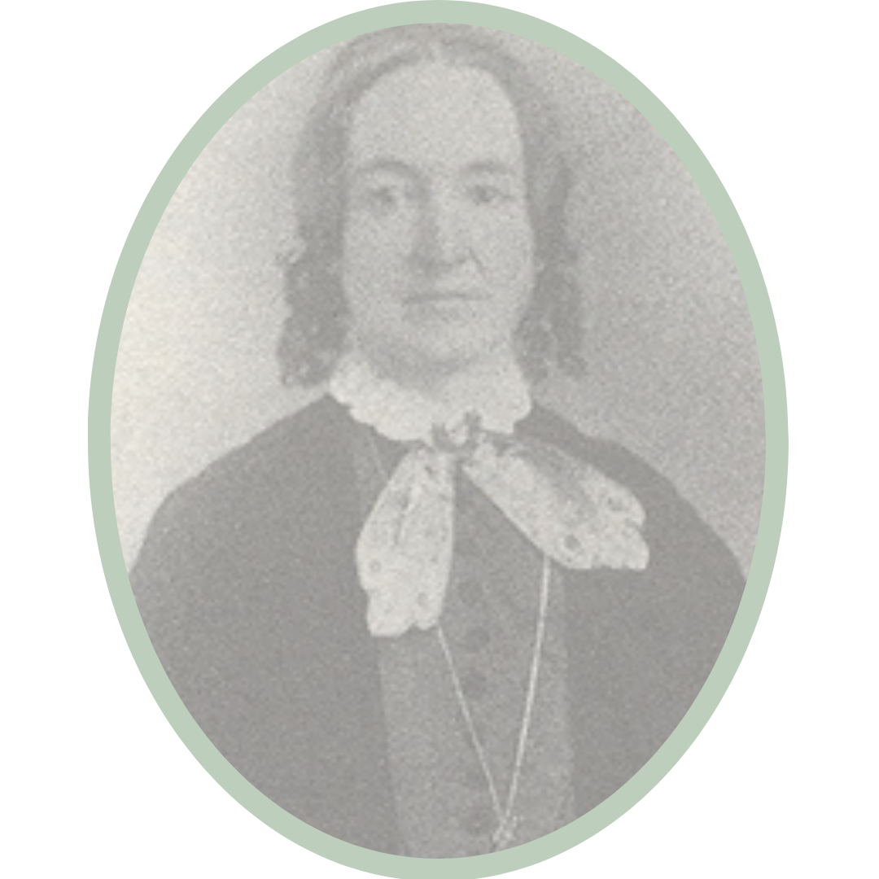
Access to Fair, Equitable Courts Has Been A
Long Standing Issue for American Women
Allowing women the right to enforce contracts and to divorce was a primary goal of the early feminist movement in this nation. But we can see that even after receiving nominal civil rights, women still suffer under separate and unequal forms of justice in this country. In 1860, Illinois woman Elizabeth Packard was institutionalized by her financially abusive, domineering husband. Her struggle to overturn laws in this country that allowed abusive men to place their wives in insane asylums helped spark the women’s rights movement. Much like modern women caught up in judicial corruption, Elizabeth had been shocked to find herself in a justice system in which women were blatantly exploited and denied constitutional protections that, even in 1860, she believed she had as an American woman.
Today’s American family courts have increasingly become the tools of abusers just as they were in the time of Elizabeth Packard. Across the US, Family Courts place domestic violence victims in secretive systems, unchecked by reviewing bodies or civil rights advocates. Undermining protective parents by labeling them as mentally ill remains an essential component of court actions that force abused children into parenting time with abusers.
Elizabeth Packard
“Woman is too volatile and spiritual, a being to be kept down by mere brute force," she [Elizabeth Packard] wrote. "You can cage a bird and thus keep her down on a level with her serpent-mate, but just give her the use of her powers, its freedom, and she will rise.”
The Woman They Could Not Silence, by Kate Moore
Now as in 1860, women are routinely denied basic civil rights in Family Courts
Courts characterized by secrecy
Women not believed or not allowed to present their position in court
Women’s credibility and competence attacked
Women forced into therapy, institutionalized for nonexistent psychiatric disorders
Judicial norms ignored
Courts as tool of coercive control for abusive men
Economic abuse of women institutionalized
contemptuouswoman.org

Slide 5
How a Family Court System Breaks Down
Brazen criminality unchecked in corrupted family court systems; Predatory appointees and judges drawn to weakened institution; open sexual abuse within court itself.
How a Family Court System Breaks Down
Overt
Corruption
Reviewing courts economically and politically incentivized to tolerate judicial abuse; State Bar Associations and ACLU abdicate duty to protect civil rights of Protective Parents.
“ParentalAlienation Industry”
family courts increasingly secretive;
judicial standards ignored;
for profit experts decide parentage matters.
Legislation toothless without oversight; Far Right voices fill media vacuum, delegitimizing voices of Protective Parents
Public indifference to plight of protective parents in
family courts; domestic violence topics deemed “private”;
under-reporting in media of child abuse, particularly sexual abuse
contemptuouswoman.org

Slide 6
Where is the Oversight?
Reviewing judges, appellate courts and supervising judges actively and aggressively protect other judges even when presented evidence of obvious misconduct
Appellate courts deny review by labeling cases permanently ongoing, which is particularly effective when judges issue rulings without jurisdiction or without a case having commenced;
Circuit Court leadership, Appellate and Federal courts staffed with former domestic relations judges who actively protect domestic relations judges;
Circuit court and appellate court clerks intentionally lose, misplace, delay and impose expense when faced with requests for records on appeal;
Nominations and endorsements to become a presiding, appellate or federal judge contingent on protecting other judges so those placed in power are vetted for their willingness to tolerate corruption.
The American Civil Liberties Union and State Bar Associations Don’t Acknowledge Potential for Civil Rights Violations in Family Courts.
As a policy, private civil rights attorneys and The ACLU deny that there are civil rights victims among litigants in family court even when these litigants face obvious due process violations;
Filing of fraudulent documents, ex parte meetings, bribery, conspiracy in financial crimes, rape and sexual harassment of female litigants and attorneys are among the crimes documented repeatedly in Chicago family courts which would be investigated had they happened in a criminal court;
Ordinary citizens believe that protective parents and children abused by corrupt family court judges and appointees must be lying because of the notable absence of support from bodies that claim to advocate for civil rights victims.
contemptuouswoman.org

Slide 7
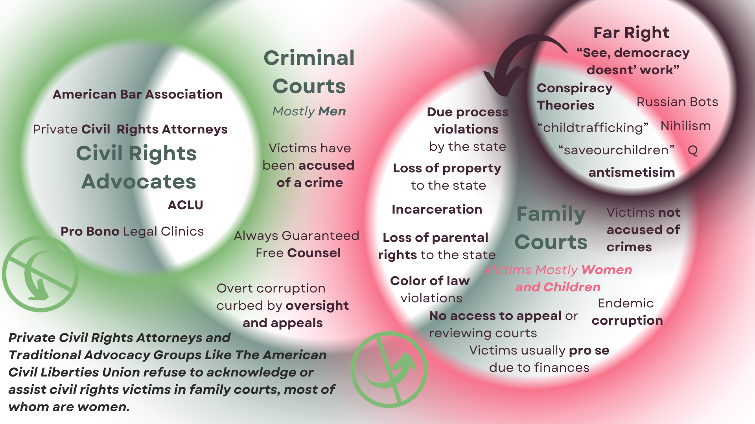
contemptuouswoman.org

Slide 8
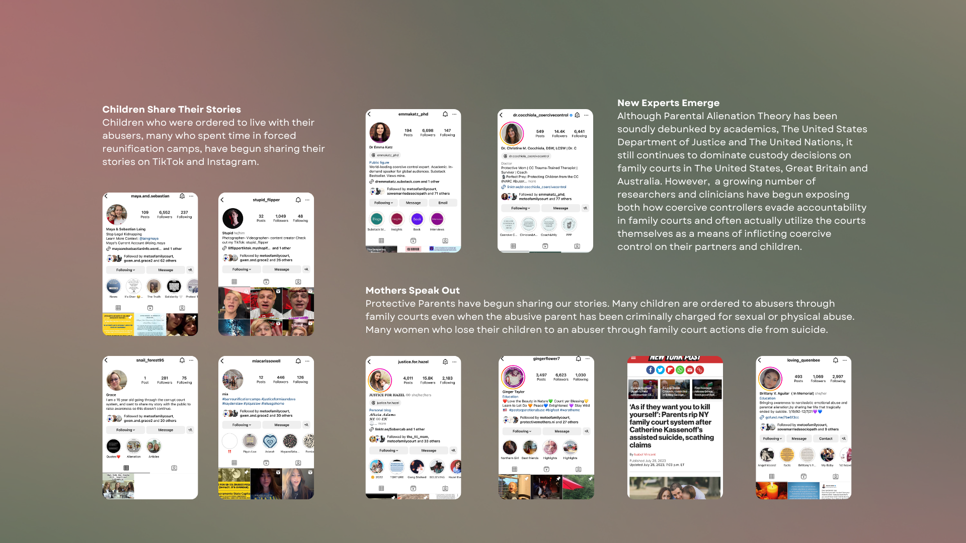
Social Media Has Allowed Victims, Survivors and Experts in The Field of Coercive Control To Connect
contemptuouswoman.org

Slide 9
There’s corruption and there’s CORRUPTION
In the spring of 2021, I discovered that I wasn’t just dealing with a bad divorce case but that my children and I are the victims of a racketeering enterprise in The Domestic Relations Division of The Circuit Court of Cook County. Basically, in Chicago powerful political patrons act as court appointed Guardian Ad Litems (GALs), deciding how parentage cases go. In return for rubber stamping GAL decisions, attorneys and associate judges are promised endorsements for future judicial campaigns. My former husband, Peter Matt, bribed a GAL named Michael Bender to take away my parental rights and to allow Peter to use the court to financially and emotionally abuse me.
I reported Peter, a brazen and sloppy financial criminal, to federal investigators two years ago because both my boys had begged not to go to his house. But instead of arresting Peter as I’d hoped, federal investigators used his attorney’s conspiracy in money laundering a a basis to set up a sting to catch dirty Chicago divorce judges. This has been going on for two years, I’m exhausted from it, I want my boys back and I want to stop being the victim of federal crimes.
I created this presentation because the acute breakdown in law in Chicago Family courts could not happen without a broader weakening of family courts which is seen globally. The systemic failures, particularly due to the Parental Alienation Industry, make the overt corruption I’ve experienced not just possible, but inevitable.
As I write, there are children being ordered to live with men who have been documented raping, beating, and tormenting them and their mothers. As I write, people are making millions of dollars, becoming judges, and getting campaign endorsements for letting this happen. I didn’t believe this could happen in this nation until it happened to me.
When our democratic institutions break down, the harm is to the entire country. Please stand up for our courts while we are still lucky enough to have them.
Follow me on Instagram
@megsybeth
Subscribe to my Substack Newsletter
“ A Contemptuous Woman”
Visit contemptuouswoman.org for more information, including videos and case documents
contemptuouswoman.org

Slide 10
What’s needed to fix America’s Family Courts
Enforcement
There is a movement now to ban Family Reunification Camps, which is important in states where children are routinely forced to attend privately managed “training” camps, to force the children to want to be with a parent they have accused of abuse. But the problem is that legislation is not effective when judges and appointees are allowed to act above the law. Many states have robust, thoughtfully drafted laws governing child custody decisions. But these laws are meaningless without enforcement. Judges and attorneys are not regulating themselves as they are supposed to do. Family law judges act as if they can do whatever they want to do because family law judges can do whatever they want to do. We need The United States Department of Justice and non-government civil rights advocates such as The ACLU to take on corruption in Family Courts as a key issue for reform and enforcement.
Advocacy
Women like me and our children are not believed. We need mainstream media outlets, civil rights advocates and public officials to start speaking on our behalf and supporting policies to protect domestic violence victims. Public education on the topic of coercive control is needed to stop the secondary abuse many protective parents experience due to the blind allegiance of community and family members to the coercive controller.
If you care about justice in our courts and want to help domestic violence victims like me and my children, please share this presentation with three people you know who care about social justice.
contemptuouswoman.org

